Slide 1
Models and Analysis for TeraTox dataset
Group 1
Paul Geser, Moritz Glubler, Zygimants Jocys,
Hoda Mazaheri, Haiyan Zhang

Slide 2
Data Preparation

Slide 3
Data Preparation
Data is provided in the supplementary data of [1]
Consists of 36 compounds with 6 different concentrations.
84 non teratogenic feature vectors, 132 teratogenic ones
[1] Optimization of the TeraTox Assay for Preclinical Teratogenicity Assessment, M. Jaklin, J. D. Zhand et al. Toxicological Sciences 188(1), 2022, 17-33
Github: https://github.com/zygiauzas/Solvingteratogenicity.git
Notes:
Morritz

Slide 4
Methods & Analysis

Slide 5
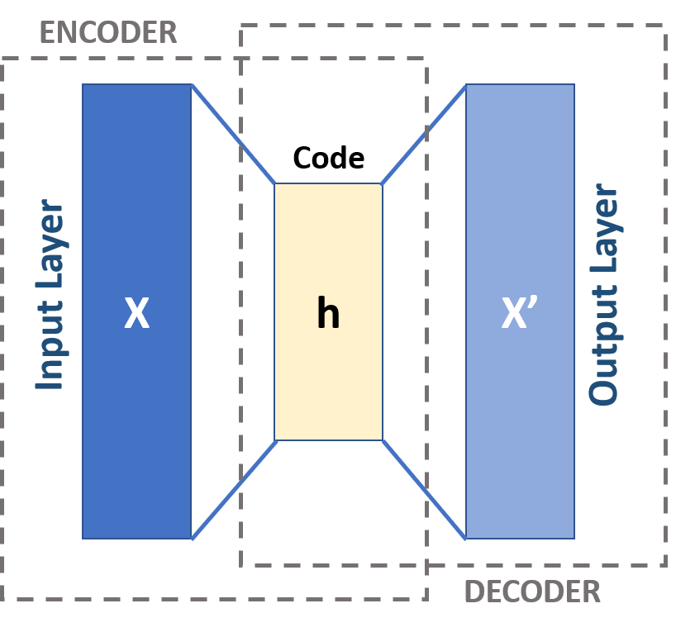
Machine learning models
Autoencoder
An autoencoder is a type of unsupervised learning neural network.
It contains 2 functions: an encoding function that transforms the input data, and a decoding function that recreates the input data from the encoded representation.
It is used to extract essential features and dimension reduction.
Notes:
Haiyan
Dimensionality reduction is a powerful tool for machine learning practitioners to visualize and understand large, high dimensional datasets. x’: x prime.

Slide 6
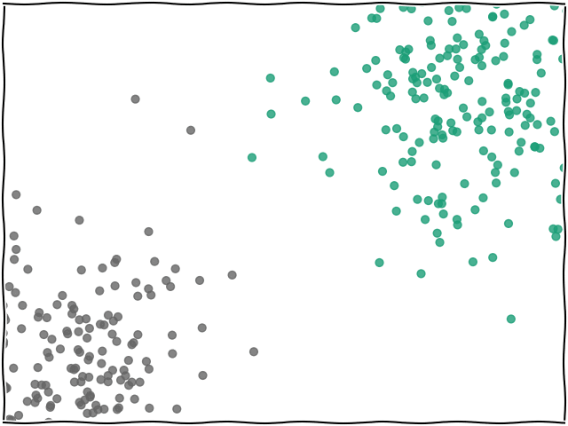
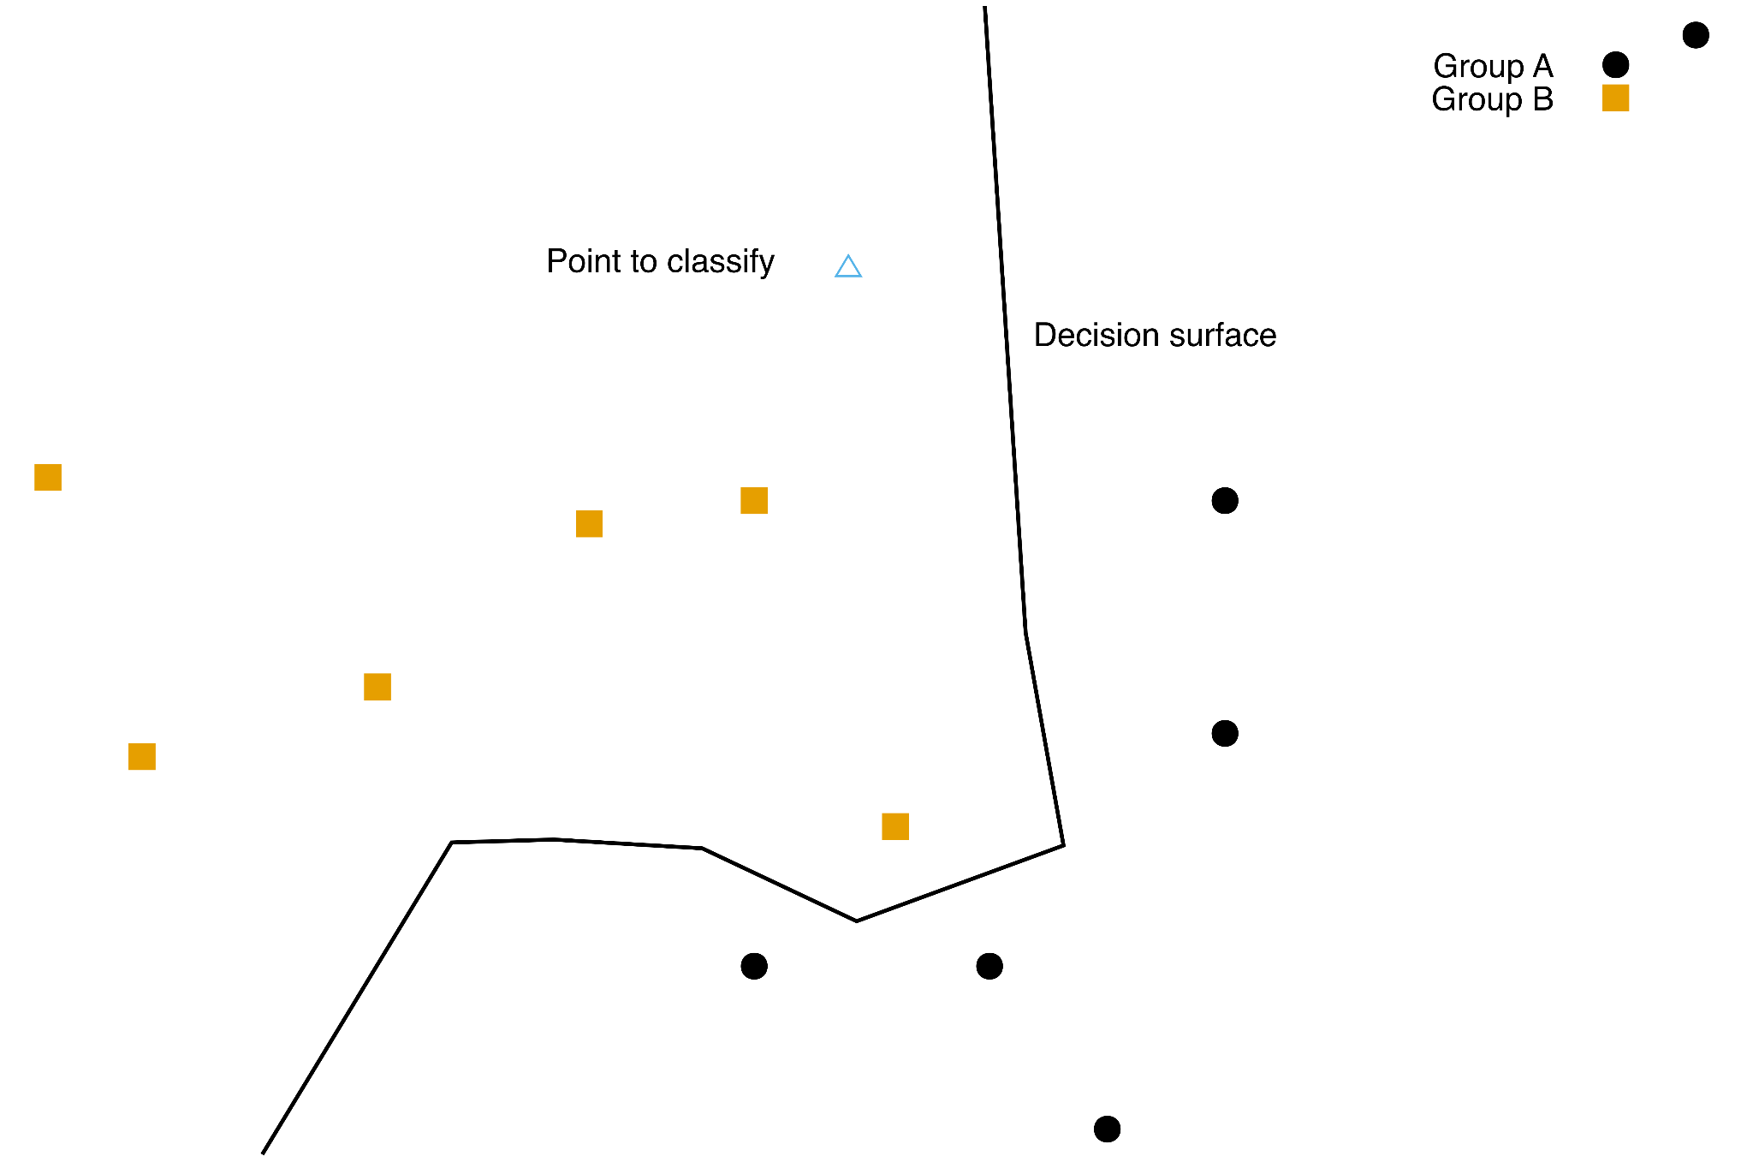
KNN
Look for the k nearest neighbours
Classify new point based on the majority of the groups in the set of k neighbours
To avoid draws, pick an odd k if only two groups are considered
We used k=1
Notes:
Moritz

Slide 7
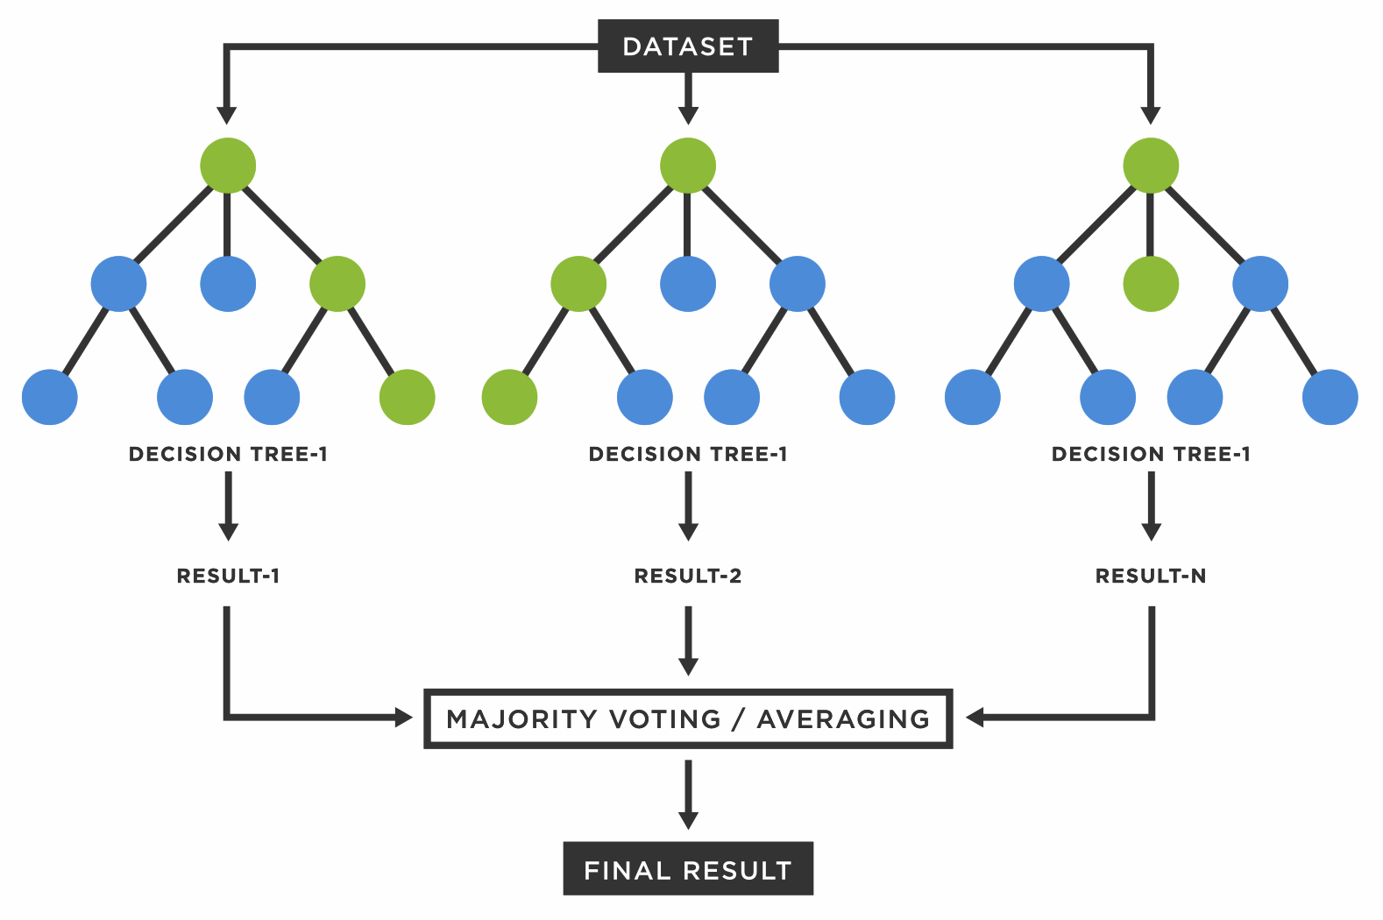
Random Forest
Random forest is a commonly-used machine learning algorithm, which combines the output of multiple decision trees to reach a single result.
Notes:
Moritz

Slide 8
Analysis
-data exploration

Slide 9
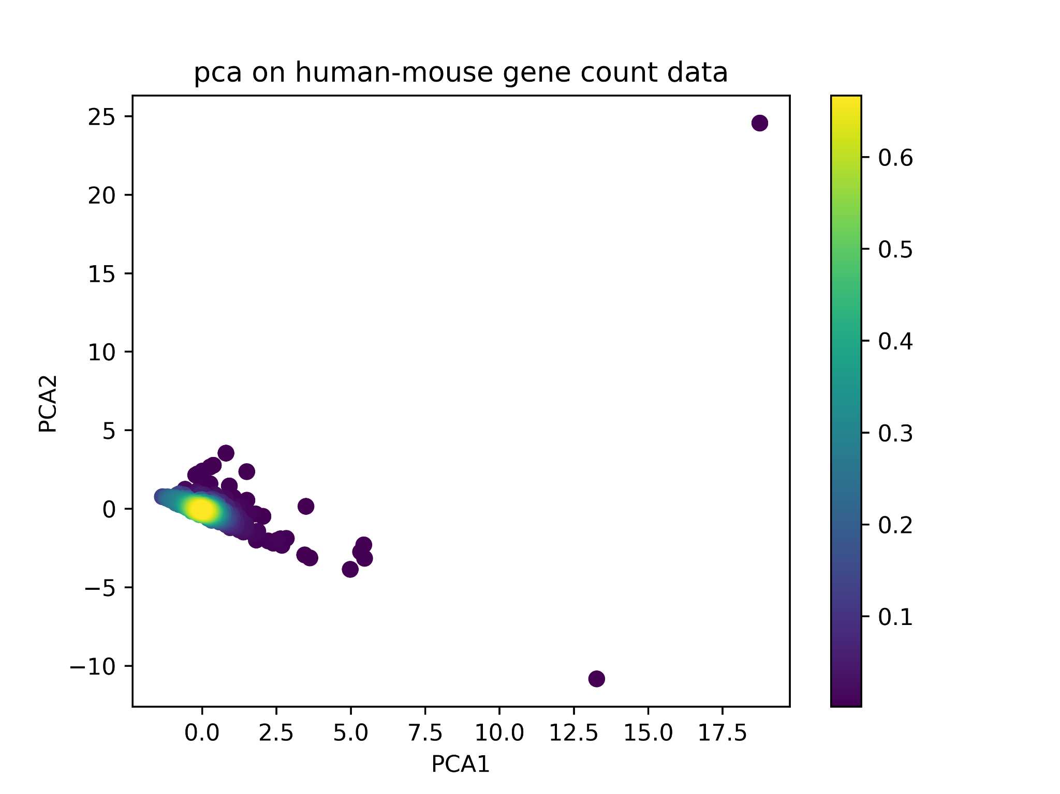
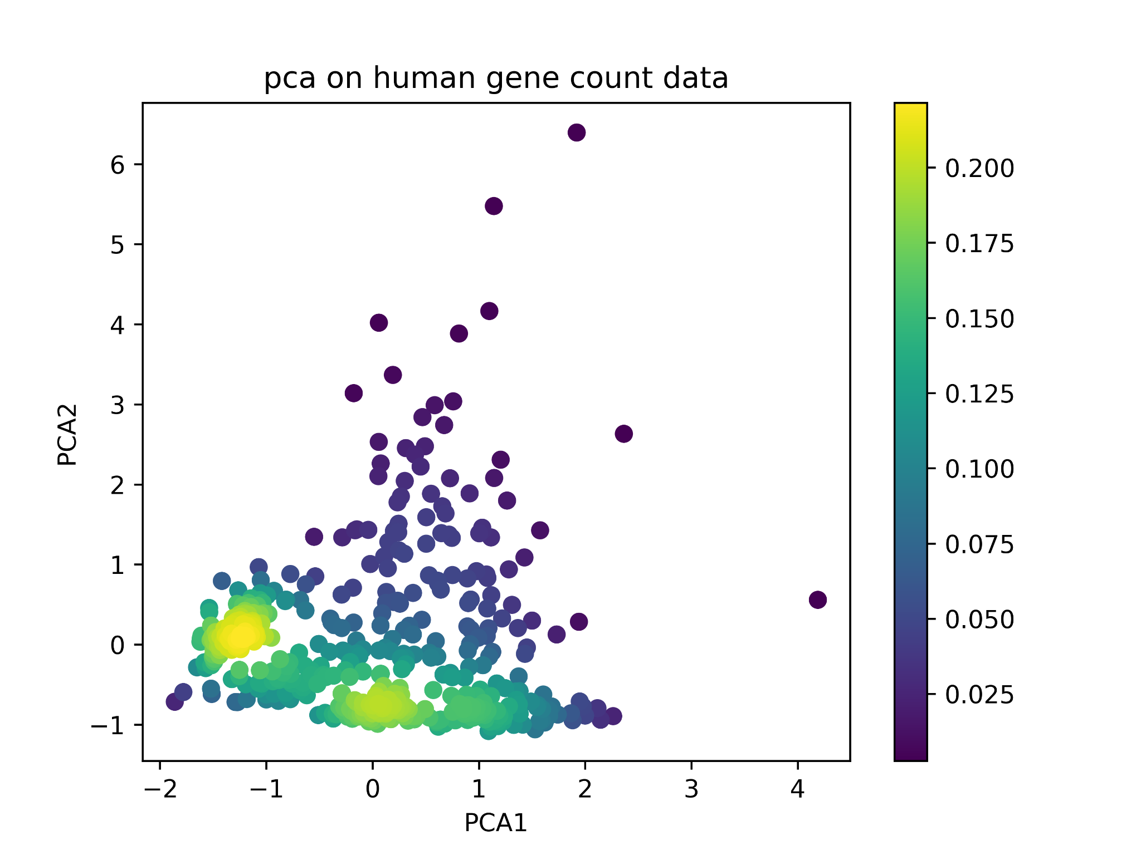
Data exploration on the gene count data - PCA
Notes:
Haiyan

Slide 10
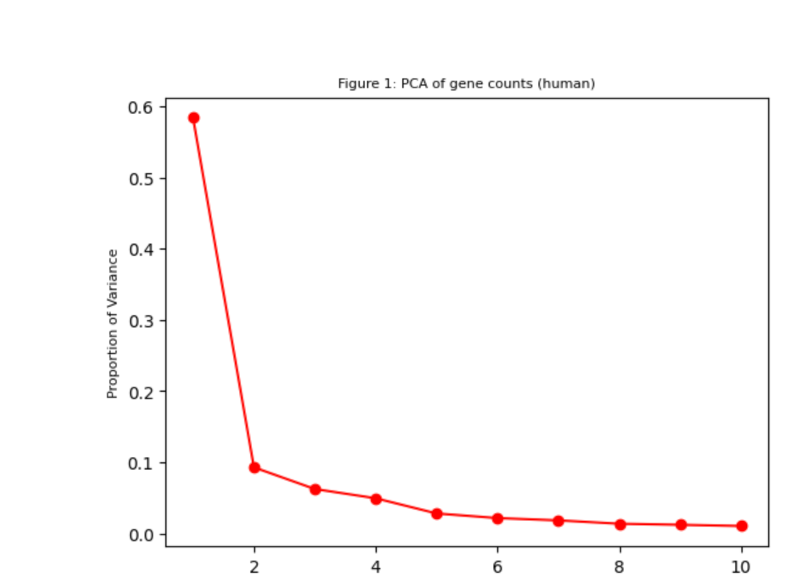
Data exploration on the gene count data - PCA
Notes:
Haiyan

Slide 11
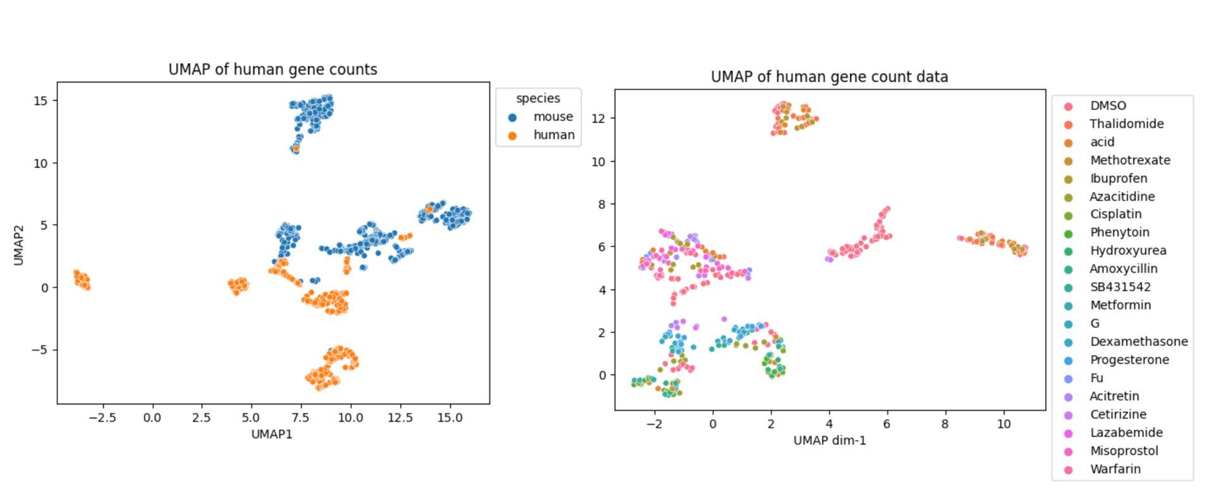
Data exploration on the gene count data - UMAP
UMAP of human-mouse gene counts
UMAP of human gene counts
Notes:
Haiyan
UMAP (Uniform Manifold Approximation and Projection) is a novel manifold learning technique for dimension reduction, is a Nonlinear dimensionality reduction.

Slide 12
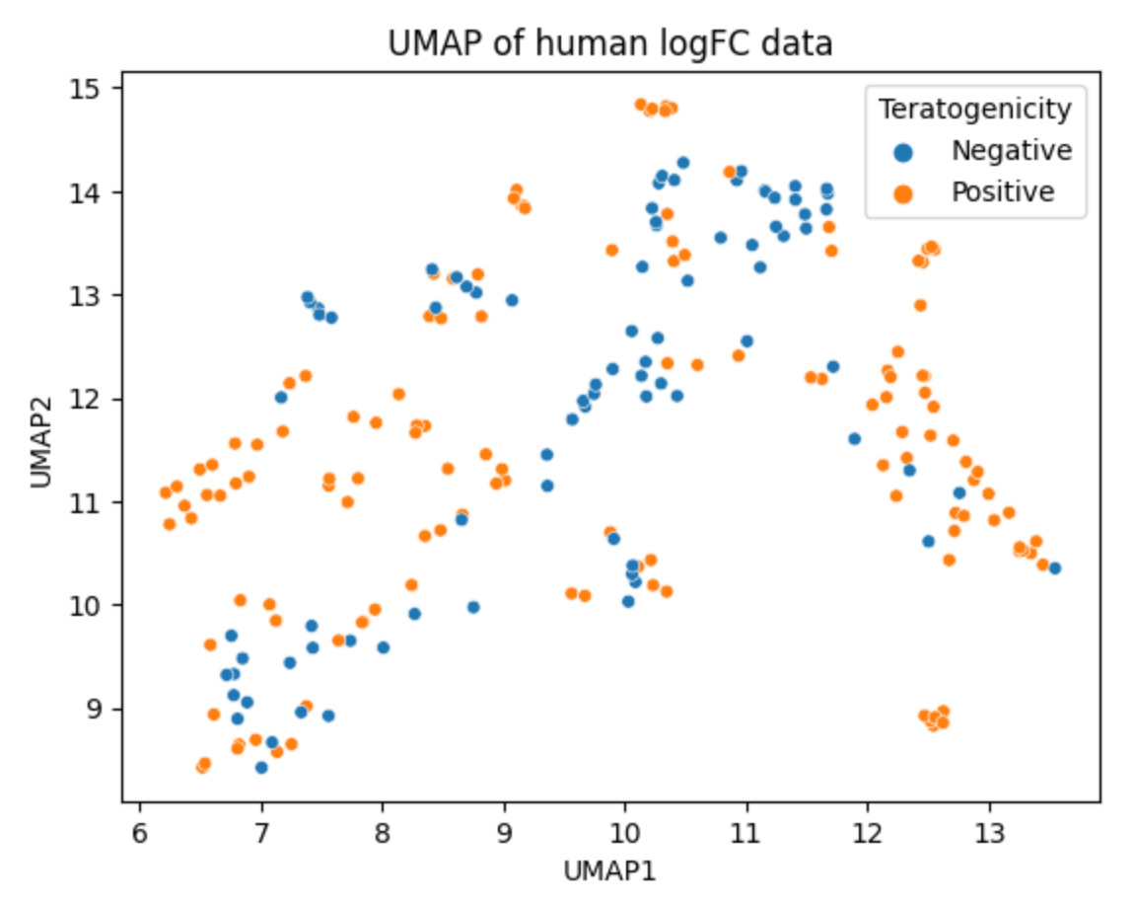
Data exploration on the logFC data - UMAP
Notes:
Haiyan

Slide 13
Factor Analysis

Slide 14
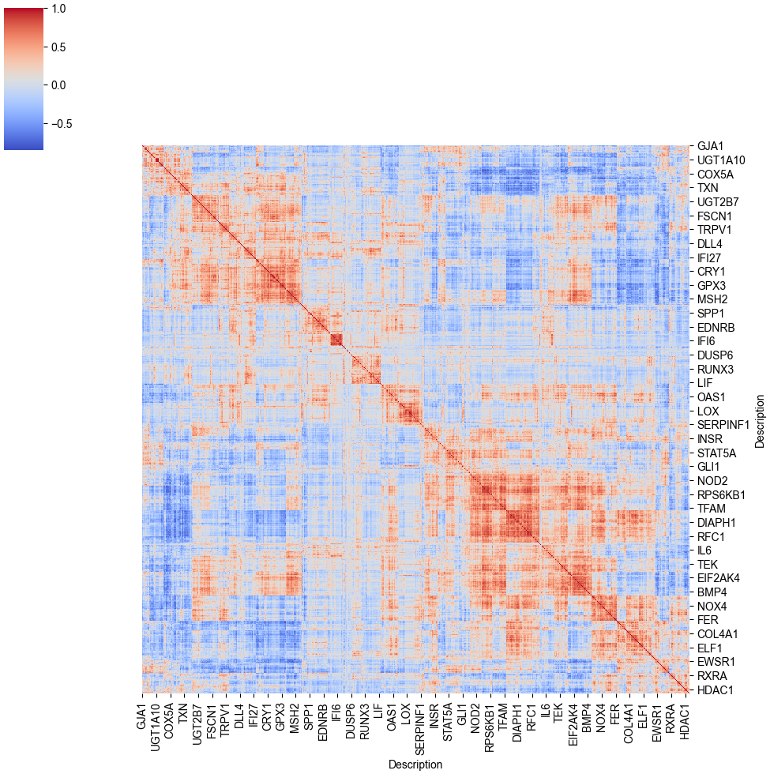
Correlation matrix from non germ-layer genes
Notes:
Hoda

Slide 15
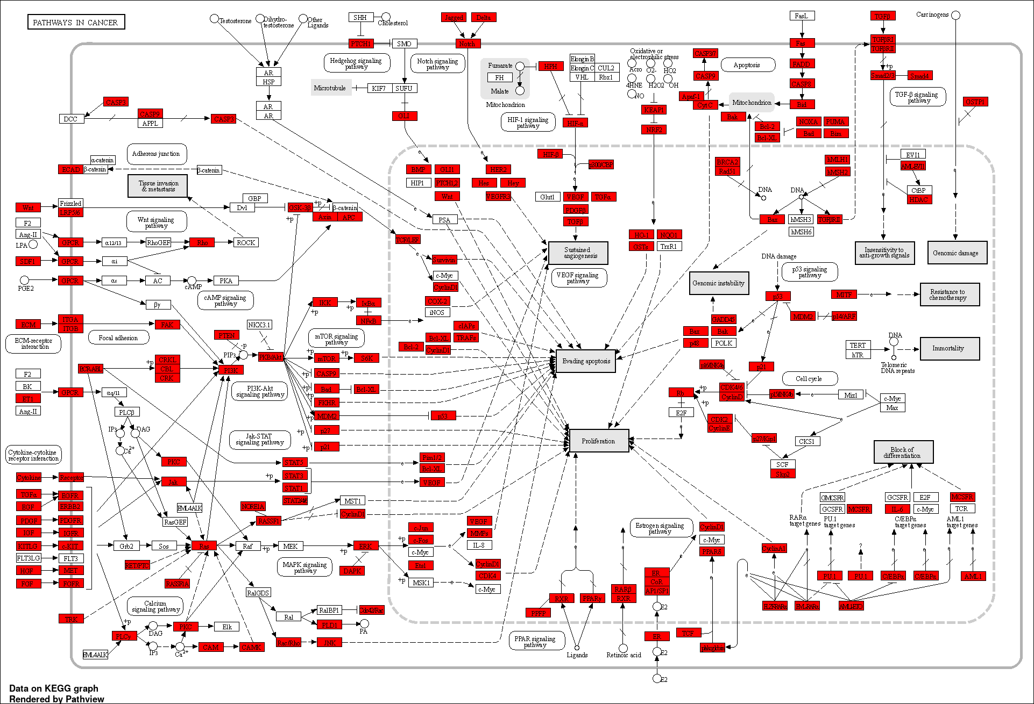
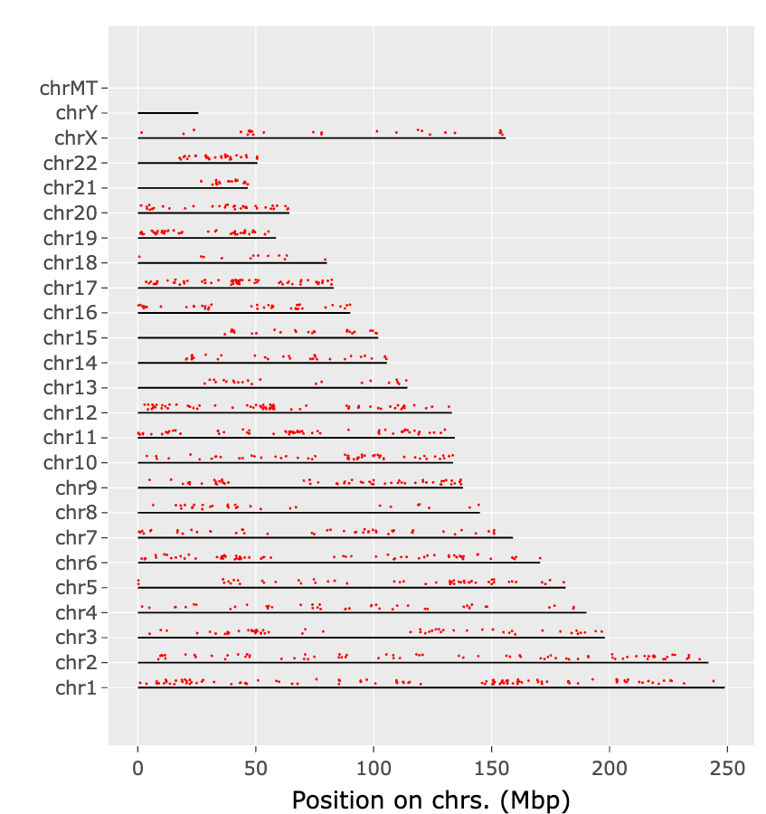
Factor analysis from non germ-layer genes
Gene enrichment analysis: ShinyGO 0.77
Notes:
Hoda

Slide 16
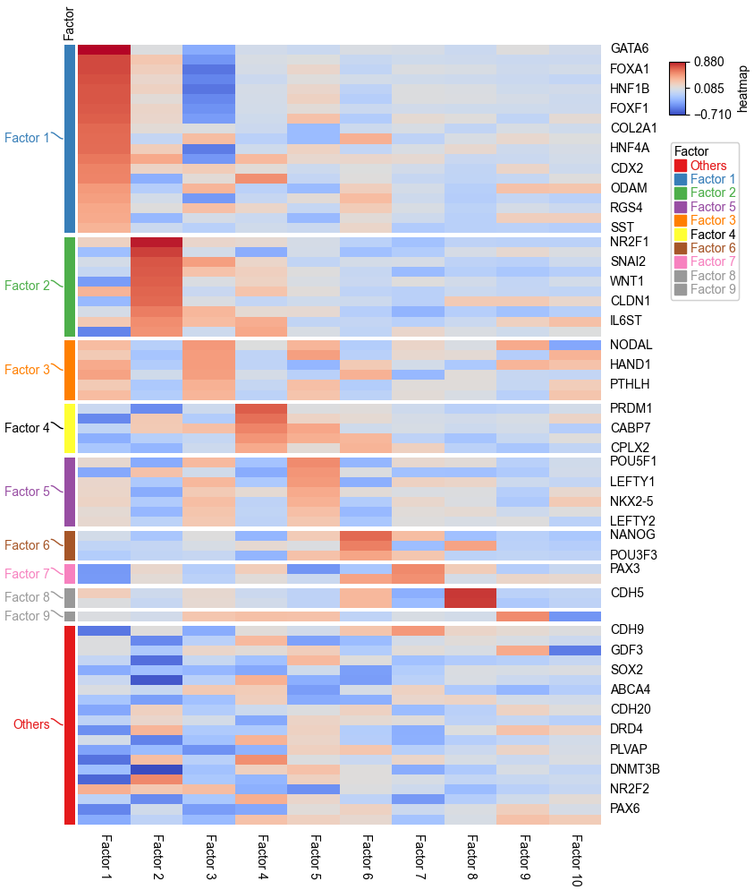
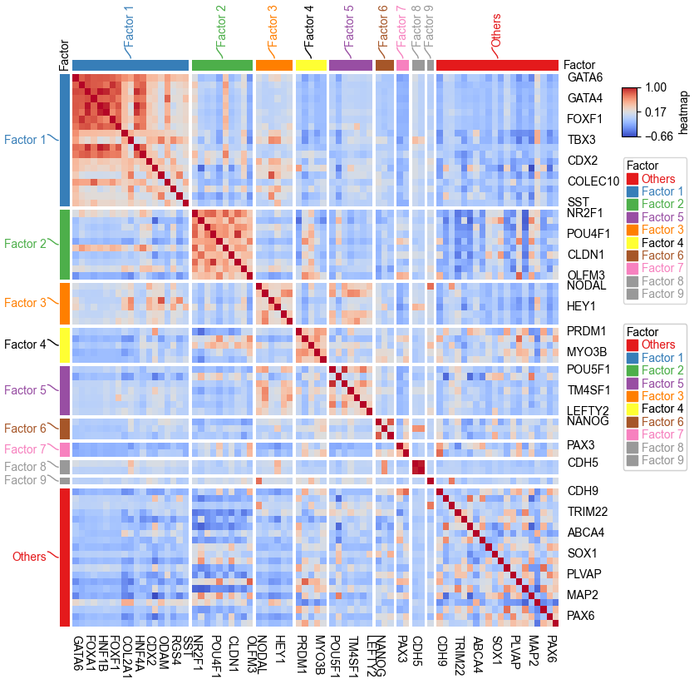
Factor analysis from germ-layer genes
Notes:
Paul

Slide 17
Machine learning models

Slide 18
Random Forest results (80%-20% splitting)
Model | Accuracy (%) | Precision (%) | Recall (%) | Specificity (%) | F₁ (%)
Random Forest (logFCdata) | 72.7 | 72.4 | 87.5 | 60 | 79.2
Autoencoder (logFCdata) +Random Forest | 79.5 | 78.8 | 92.9 | 56.3 | 85.2
Notes:
Haiyan

Slide 19
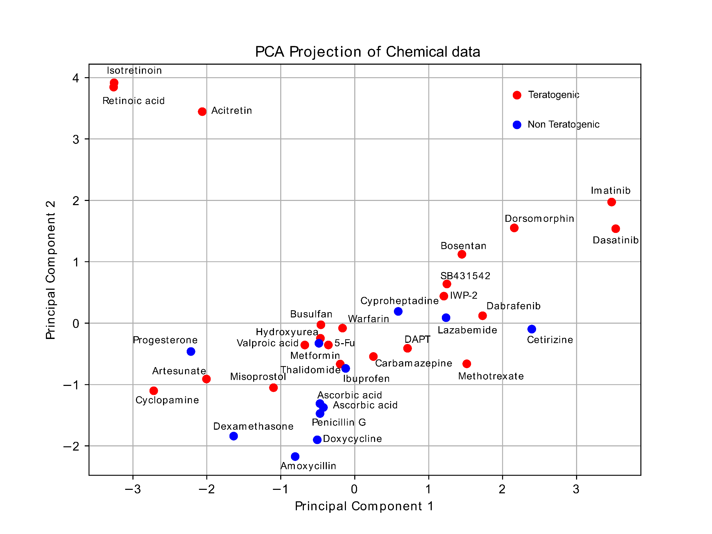
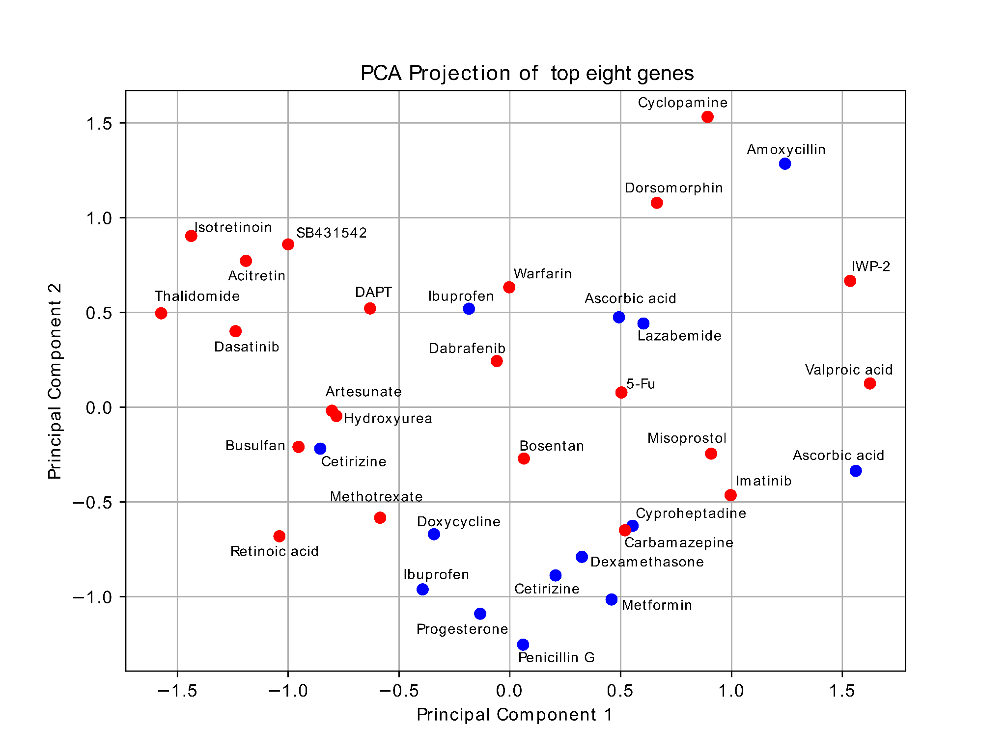
Data exploration - PCA
Chemical structure
Gene expression
Notes:
Moritz

Slide 21
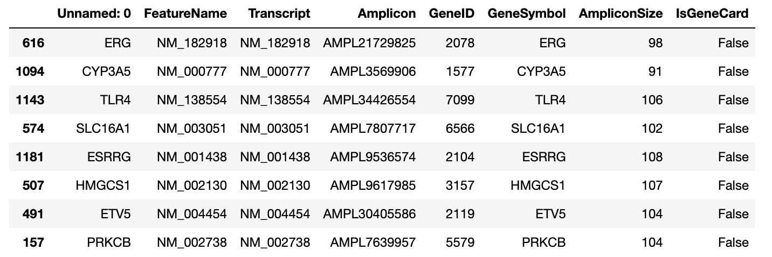
Stress related genes carry the most Mutual Information
Notes:
Zygis

Slide 22
Results LOO
Model | Accuracy (%) | Precision (%) | Recall (%) | Specificity (%) | F₁ (%)
TeraTox | 69 | 73 | 79 | 53 | 76
Morgan Fingerprint | 72.2 | 82 | 75 | 66.6 | 78.3
1-NN Cosine Similarity on Log Fold Change (FC) | 61.2 | 78 | 73.6 | 50 | 68
RF with max 10 trees on 8 MI features | 89 | 91 | 91 | 86 | 91
Notes:
Zygis

Slide 23
Results 5-fold
Model | Accuracy (%) | Precision (%) | Recall (%) | Specificity (%) | F₁ (%)
Morgan Fingerprint | 70 | 93 | 70 | 60 | 78
1-NN Cosine Similarity on Log Fold Change (FC) | 64.2 | 69 | 71 | 37 | 67.7
RF with max 10 trees on 8 MI features | 61.2 | 77 | 71 | 42 | 71
Notes:
zygis

Slide 24
Conclusions
Notes:
All

Slide 25
We need more data and do proper k-fold cross validation with LOO we otherfit when we 5 fold cross validation we get the results worse than with morgan fingerprints

Slide 26


Slide 27
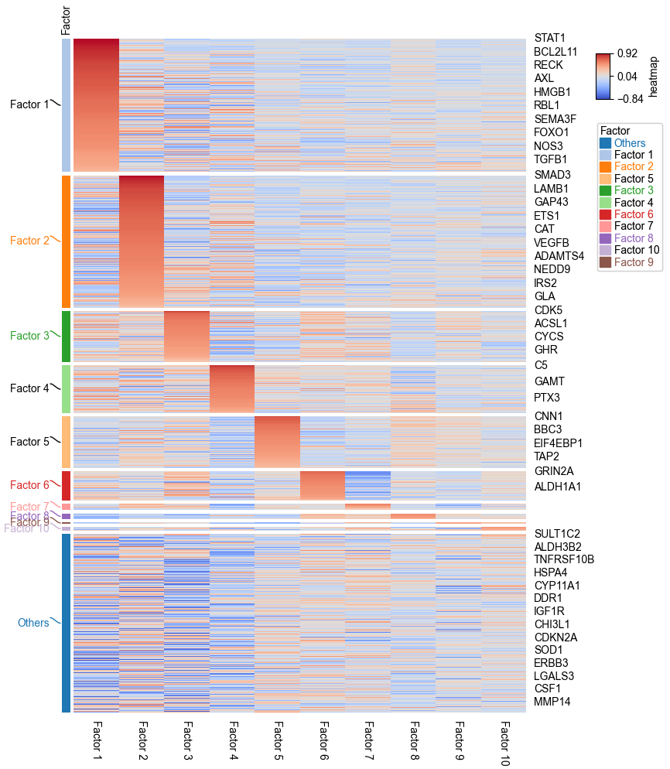

Slide 28
